Slide 1
Student Visa Information Session
International Student Support
December 2022
Ana Korniienko, Sarah Attaullah
International Student Support Team

Slide 2
Student Visa Route
The Student visa route replaced Tier 4 on the 5th October 2021
New Guidance and Appendix’s introduced to describe new rules
ISST Student Visa Guides are updated and available to download from UWS webpages https://www.uws.ac.uk/international/visas-immigration-atas/

Slide 3
HOW TO PREPARE FOR A SUCCESSFUL STUDENT VISA APPLICATION ?
Every visa application requires good preparation. Please follow these steps below

Slide 4
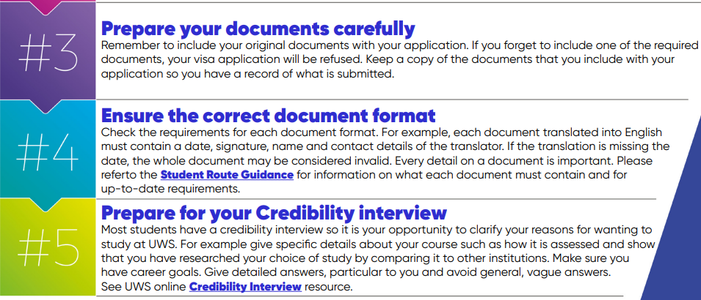
HOW TO PREPARE FOR A SUCCESSFUL STUDENT VISA APPLICATION ?
Every visa application requires good preparation. Please follow these steps below

Slide 5
Prepare your Financial Evidence
Maintenance for course of 9 months or more
£9,207 for Scottish Campus, £12,006 for London Campus.
Tuition fees paid in full, any remaining fees (as listed on CAS) must be shown in addition to maintenance

Slide 6
Financial Evidence - Bank Statements
Money in account for continuous 28 day period prior to application. Statement not more than 31 days old on date of application
Money available immediately (not subject to a notice period)
Bank account in your name, parent(s) name, Dependant partner name (only if applying at same time) or joint account including your name

Slide 7
Financial Evidence - Parents
In addition to requirements detailed in bank statements slide:
In name of either or both parent(s)/legal guardian(s) only – not other relatives
Statements in parents’ name not company name
Original birth certificate/adoption certificate and official certified translation if not in English
Signed letter from parents confirming you are their son/daughter and permission to use their funds

Slide 8
Financial Evidence - Official Financial Sponsor Letter
Letter of permission is required if previously fully funded, even if financial sponsorship is not continuing
Sponsor letter should show new extended course end date
Issued recently (recommend no more than 6 months old)
Official letterhead and stamp
List all dependants (if applicable)
If sponsor is providing maintenance/ living costs, then the letter must state how much you receive per year/ month OR give a statement confirming your living costs will be paid in full.

Slide 9
Applying for a CAS
Students applying for a new course will receive a CAS as part of application process (after receiving unconditional offer and meeting all UKVI requirements as well as confirmation agreed tuition fees are paid)
For more information please contact International Centre international@uws.ac.uk or Admissions Team CASRequest@uws.ac.uk.

Slide 10
How to apply for the Student Visa
Apply online https://www.gov.uk/student-visa/
Download our ISST Student Visa Guide to help you
Create an account and fill in your personal and course information (you will need your CAS to complete the online application)
Declaration – not able to change / edit the application after signing this
Pay - pay the IHS then the application fee
Biometric appointments
You must upload documents online/ via IDV app
You may be asked to attend a credibility interview

Slide 11
Cost of Applying
Application Fee (for each applicant)
Please check Visa Application Fees (visa-fees.homeoffice.gov.uk)
For Priority and Super Priority Services please check fees and availability online
Immigration Health Surcharge (for each applicant)
Must be paid in addition to Student application fee for all applicants.
£470 per year of visa granted for each applicant / £235 up to 6 months (including time for wrap up period)
No exemption for private healthcare
Pay for UK healthcare as part of your immigration application: How much you have to pay - GOV.UK (www.gov.uk)

Slide 12
Filling out your Student application
Most of the information you need is on your CAS
Always include any visa refusal/convictions or penalties/medical treatment information - deception
The Sponsor’s address is always: University of the West of Scotland, Paisley Campus, High Street, Paisley, Renfrewshire PA1 2BE (download our guide to help you fill out the form)

Slide 13
Checklist of documents required
Valid passport
CAS
Qualifications/Academic certificate
ATAS certificate (if applicable)
Evidence of maintenance funds (if applicable)
Letter of permission and your birth certificate (if applicable - only if using parent bank statements)
Letter confirming funding/ permission from financial sponsor (if applicable
PLEASE SEE THE GUIDE FOR MORE DETAILS

Slide 14
Ensure the correct document format. Check the requirements for each document format. For example, each document translated into English must contain a date, signature, name and contact details of the translator. If the translation is missing the date, the whole document may be considered invalid. Every detail on a document is important. Please refer to the Student Route Guidance.
Most students have a credibility interview so it is your opportunity to clarify your reasons for wanting to study at UWS. For example give specific details about your course such as how it is assessed and show that you have researched your choice of study by comparing it to other institutions. Make sure you have career goals. Give detailed answers, particular to you and avoid general, vague answers.

Slide 15
Useful Websites
Immigration & Visa Information for Prospective Students | UWS
International Student visa guide (applying outside the UK)
Student application form
https://www.gov.uk/student-visa/
UK Council for International Student Affairs (UKCISA)
www.ukcisa.org.uk

